Slide 1
淺談數學模型與生態學
清大數學系
許世壁
Jan. 30, 2011 2011高中教師清華營

Slide 2
I. 影響人類的生態數學模型
(1) Malthusin Model (The Exponential Law)
Malthus (1798) proposed a mathematical model which assume the rate of growth is proportional to the size of the population. Let be the population size, then
where is called per capita growth rate or intrinsic growth.

Slide 3
Then
馬爾薩斯在其書 ”An Essay on the Principle of
population” 提出馬爾薩斯人口論。其主張為
人口之成長呈幾何級數，糧食之成長呈算術級數。
The rule of 70 is useful rule of thumb.
1% growth rate results in a doubling every 70
years. At 2% doubling occurs every 35 years.
(since )

Slide 4
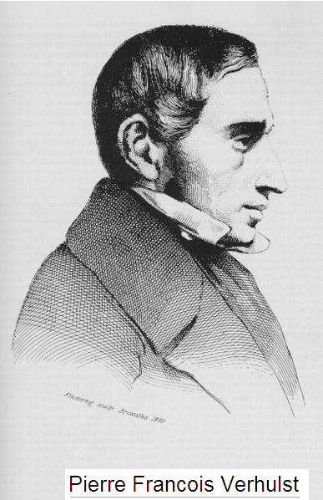
(2) Logistic Equation
Pierre-Francois Verhult
(1804-1849) in 1838 proposed
that the rate of reproduction to
proportional to both existing
population and the amount of
available resources.

Slide 5
Let be the population of a species at time ,
Due to intraspecific competition

Slide 6
Besides ecology, logistic equation is widely
applied in
Chemistry: autocatalytical reaction
Physics: Fermi distribution
Linguistics: language change
Economics:
Medicine: modeling of growth of tumors

Slide 8
Robert May ( Ph.D in plasma physics) 1970
As

Slide 9
Period-doubling cascade:
Logistic map shows a route to chaos by
period-doubling

Slide 10
is called the universal number discovered by
Feigenbaum. The number is independent of
the maps, for example

Slide 11
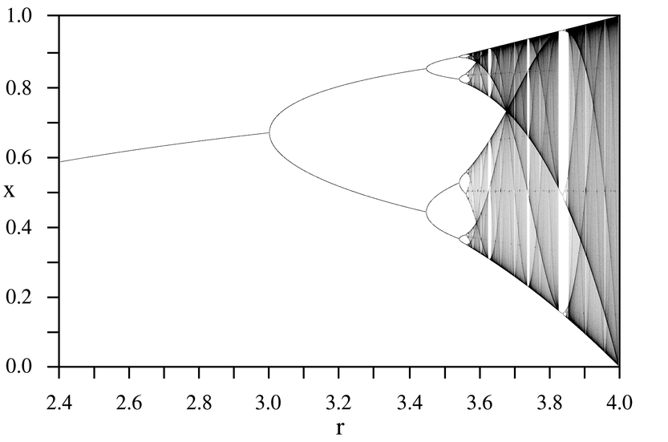
http://en.wikipedia.org/wiki/Logistic_map http://demonstrations.wolfram.com/LogisticMapOnsetOfChaos/

Slide 12
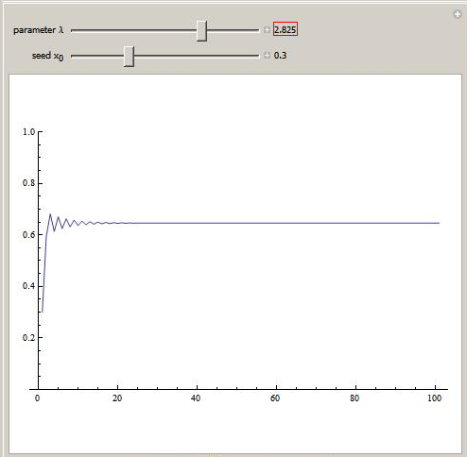

Slide 13
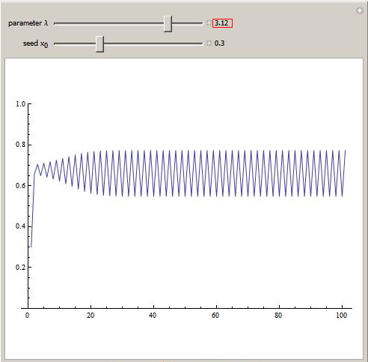

Slide 14
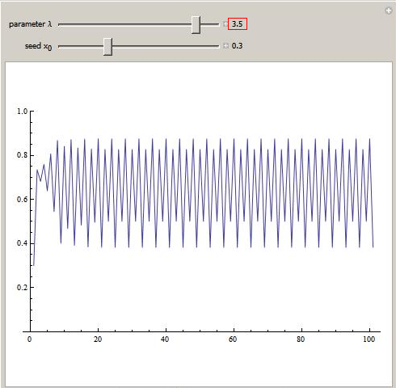

Slide 15
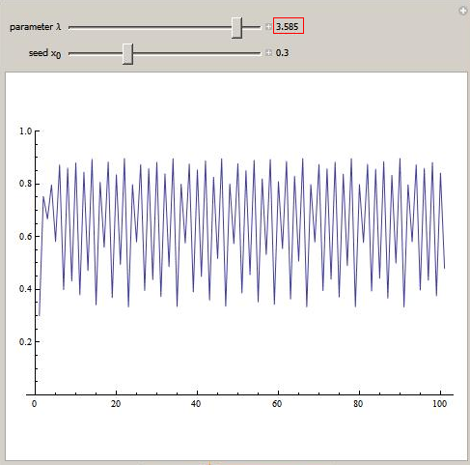

Slide 16
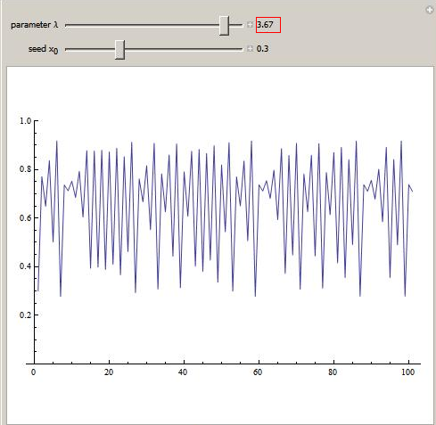

Slide 17
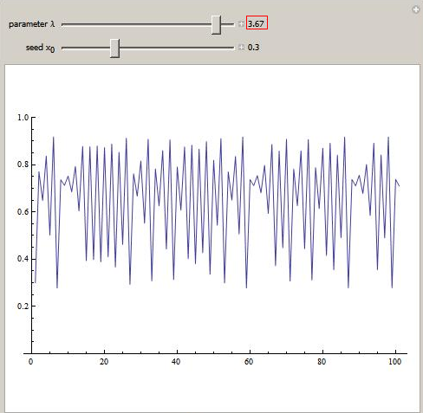

Slide 18
The bifurcation diagram is a fractal (碎形):
If you zoom in on the value r=3.82 and focus
on one arm of the three, the situation nearby
looks like a shrunk and slightly distorted
version of the whole diagram

Slide 19
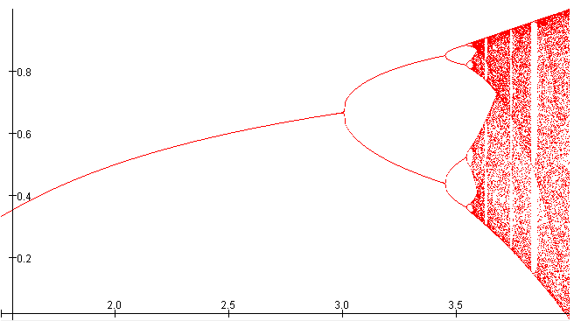
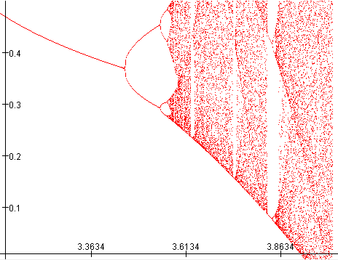
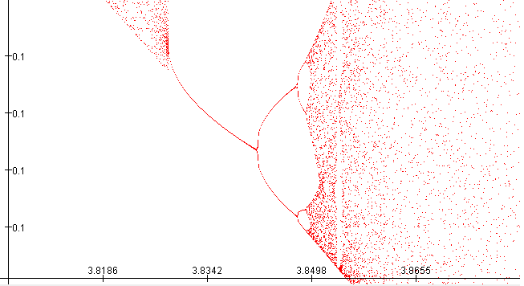

Slide 20
Chaos in the sense of Li and Yorke
Reference: Li (李天岩, 清華1968) and Yorke,
Period three implies chaos, AMS Monthly (1975)
is chaotic if
Period three period
If has a periodic point of least period not a power of 2,
then “Scramble” set S (uncountable) s.t.
(a) in S
(b) period point of

Slide 21
Shorkovsky Theorem(1960):
Sharkovsky ordering
If and f has periodic point of period
Then f has a periodic point of period .

Slide 22
Chaos in the sense of Devaney
is chaotic on if
has sensitive dependence on initial conditions.
is topological transitive
Periodic points are dense in
is topological transitive if for
there exists such that

Slide 23
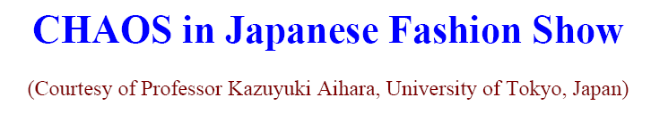


Fashion Dress, designed and
made by Eri Matsui, Keiko
Kimoto, and Kazuyuki Aihara
(Eri Matsui is a famous fashion
designer in Japan)
This dress is designed based on the
bifurcation diagram of the logistic map

Slide 24
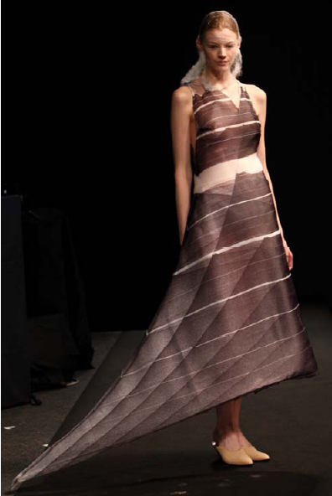
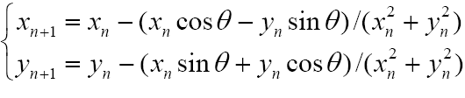
This dress is designed based on
the following two-dimensional
chaotic map:

Slide 25
Lotka-Volterra Predator-Prey model
In the mid 1930’s, the Italian biologist Umberto
D’Ancona was studying the population variation of
various species of fish that interact with each other.
The selachisns (sharks) is the predator and the
food fish are prey. The data shows periodic
fluctuation of the population of prey and predator.
The data of food fish for the port of Fiume, Italy, during the years 1914-1923:
1914 | 1915 | 1916 | 1917 | 1918 | 1919 | 1920 | 1921 | 1922 | 1923
11.9% | 21.4% | 22.1% | 21.2% | 36.4% | 27.3% | 16.0% | 15.9% | 14.8% | 10.7%

Slide 26
He was puzzled and turn the problem to his
colleague, Vito Volterra, the famous Italian
mathematician. Volterra constructed a mathematical model to explain this phenomenon.
Let be the population of prey at time . We
assume that in the absence of predation,
grows exponentially. The predator consumes
prey and the growth rate is proportional to the
population of prey, is the death rate of
predator

Slide 28
Periodic orbits in phase plane

Slide 29
Independently Chemist Lotka(1920)
Independently Chemist Lotka(1920) proposed a
mathematical model of autocatalysis
Where is maintained at a constant
concentration . The first two reactions are
autocatalytic. The Law of Mass Action gives

Slide 30
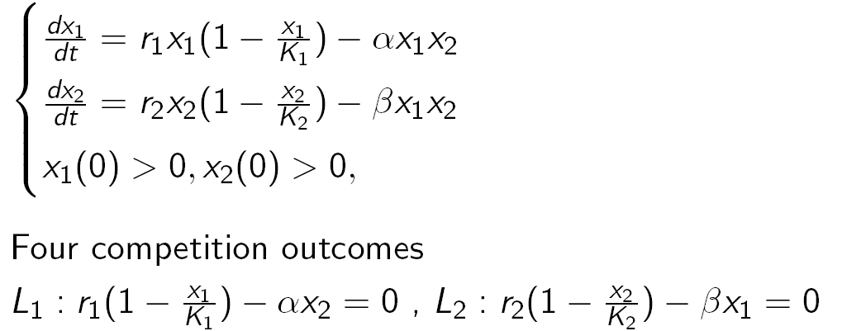
Classical Lotka-Volterra Two-Species Competition Model

Slide 31
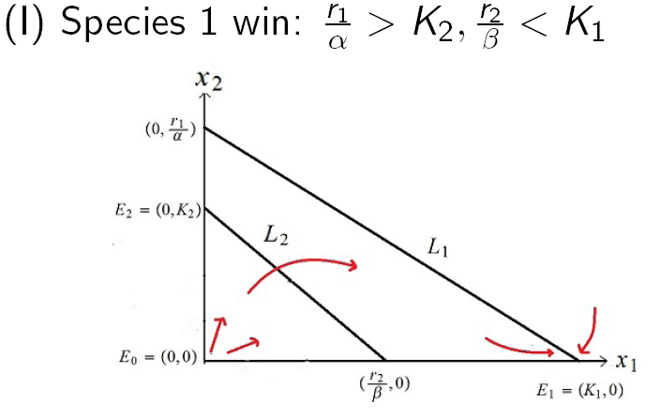

Slide 32
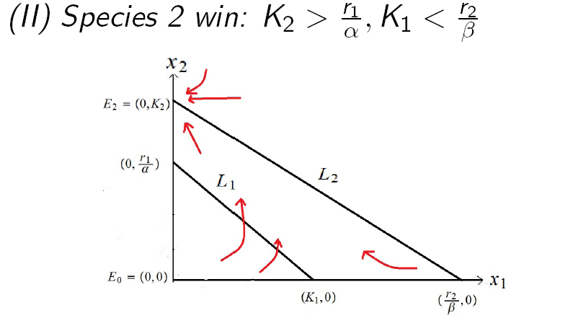

Slide 33
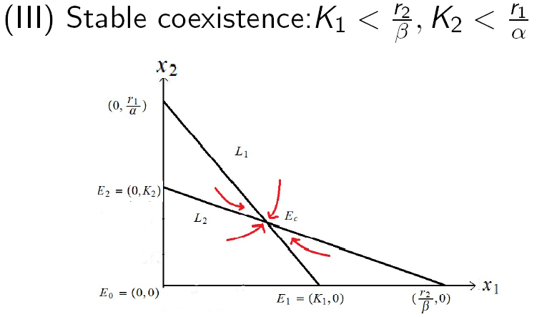

Slide 34
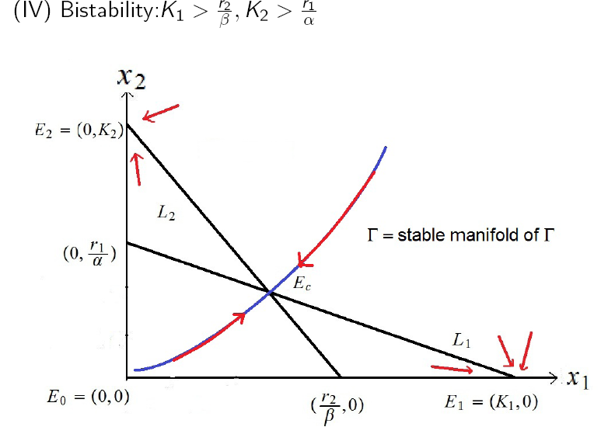

Slide 35
Competition of Three Species
(Robert May 1976) 剪刀、石頭、布
We assume:
has same intrinsic growth rate
In the absence of , win over .
In the absence of , win over .
In the absence of , win over .

Slide 37
Thank you for your attention.

